Slide 1
Minor Project
Custom Object Detection for Blood Cell Count using
Convolution Neural Network
Progress Presentation
Project guide: Team: Sanidhya Kumar
Dr. Mahesh Jangid Satabdi Nayak
Assistant Professor
Department of CSE

Slide 2
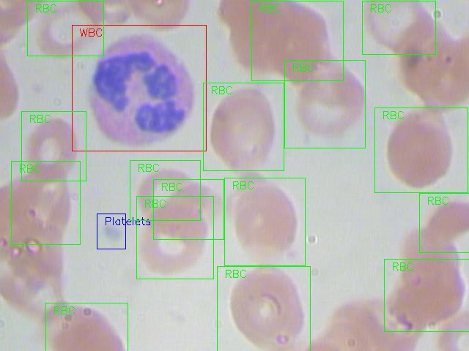
Problem Statement/Objectives
The project aims to incorporate state-of-the-art technique for custom object detection with the goal of achieving high accuracy with a real-time performance.
We will be working on a healthcare related dataset and the aim here is to solve a Blood Cell Detection problem. Our task is to detect all the Red Blood Cells (RBCs), White Blood Cells (WBCs), and Platelets in each image taken via microscopic image readings. Below is a sample of what our final predictions should look like:
The reason for choosing this dataset is that the density of RBCs, WBCs and Platelets in our blood stream provides a lot of information about the immune system and hemoglobin. This can help us potentially identify whether a person is healthy or not, and if any discrepancy is found in their blood, actions can be taken quickly to diagnose that.
Manually looking at the sample via a microscope is a tedious process. And this is where Deep Learning models play such a vital role. They can classify and detect the blood cells from microscopic images with impressive precision.

Slide 3
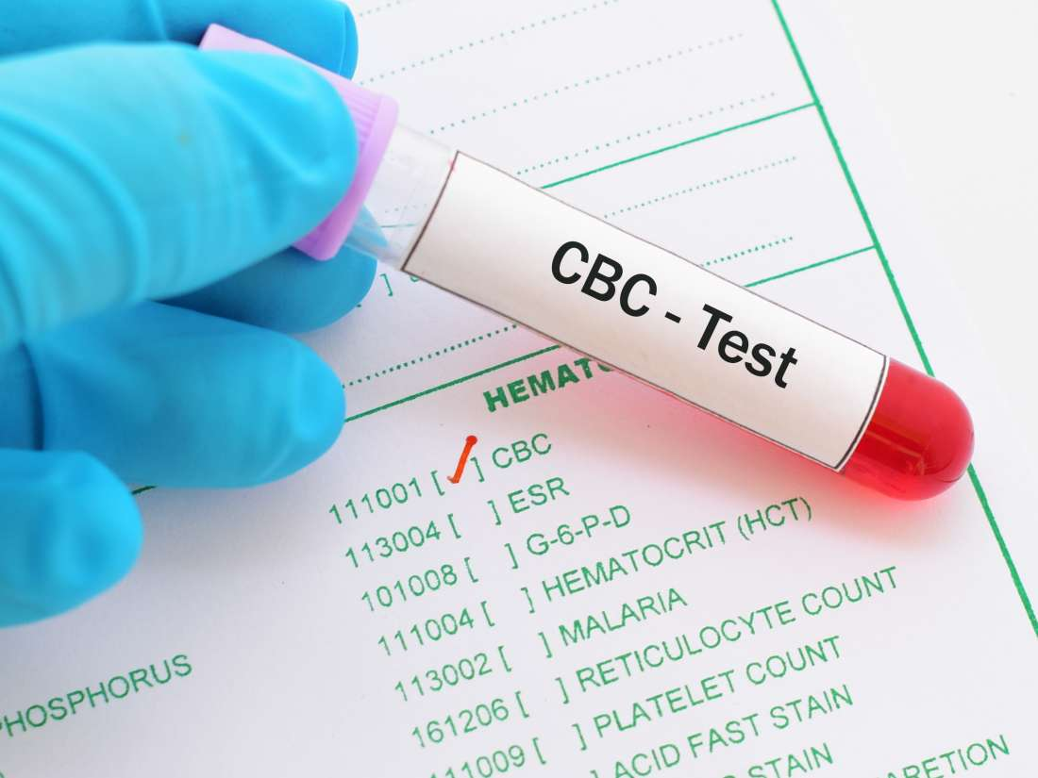
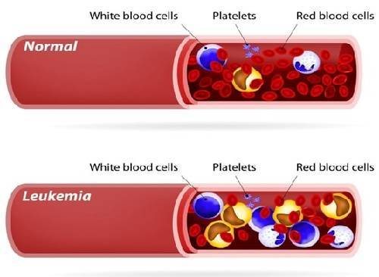
Applications
CBC (Complete Blood Count)-Count RBC,WBC, platelets.
help detect blood diseases and disorders, such as malaria, anemia,leukemia, infections, clotting problems, blood cancers, and immune system disorders.
To detect deficiency of minerals and vitamins in body.
To detect presence of an alien entity in blood.

Slide 4
How Object Detection Works?

Slide 5

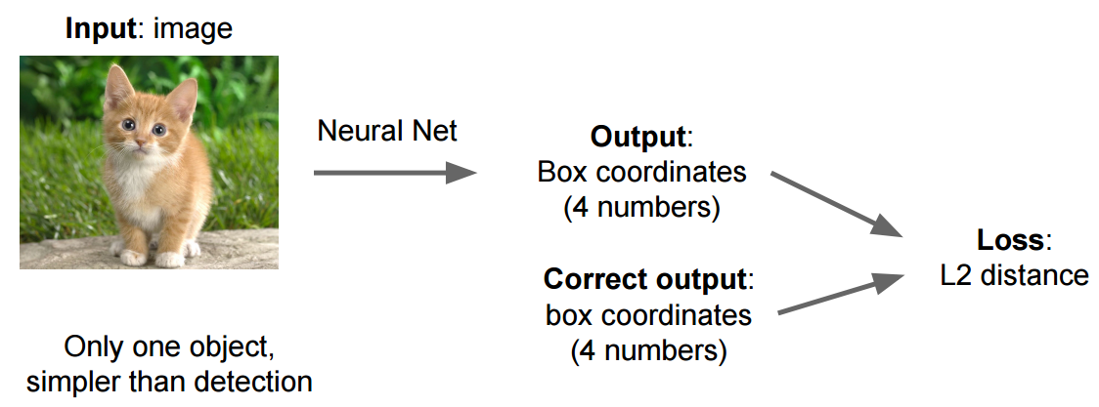
Target Specification
To demonstrate the effectiveness of our approach, our implementation will support several feature extraction and detection algorithms for evaluation and comparison purposes. In our case we're going to return 4 numbers (x0,y0,width,height) that are related to a bounding box. You train this system with an image an a ground truth bounding box, and use L2 distance to calculate the loss between the predicted bounding box and the ground truth.

Slide 6
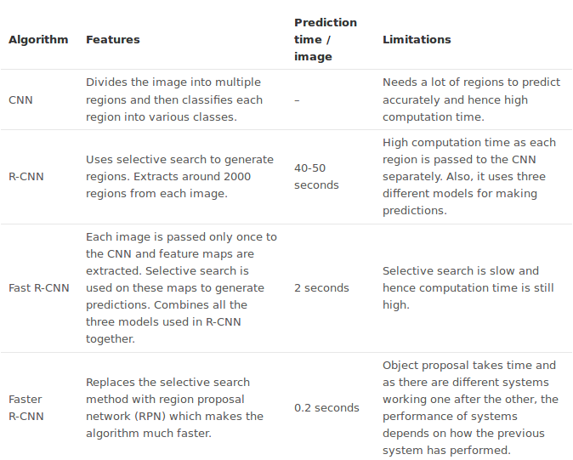
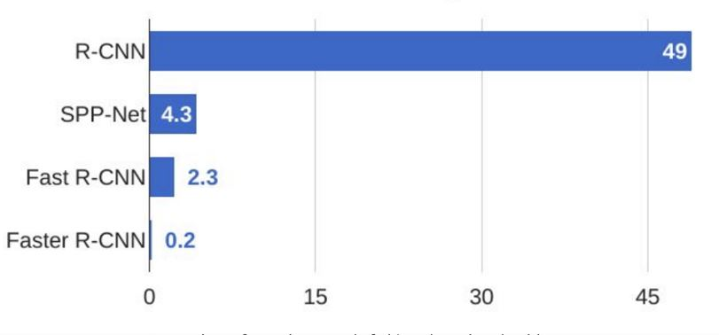
RCNN, Fast RCNN and Faster RCNN Models
Let’s quickly summarize the different algorithms in the R-CNN family (R-CNN, Fast R-CNN, and Faster R-CNN).

Slide 7
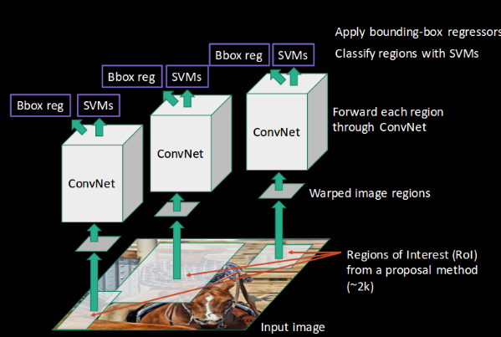
RCNN
R-CNN extracts a bunch of regions from the given image using selective search, and then checks if any of these boxes contains an object.
We first extract these regions, and for each region, CNN is used to extract specific features. Finally, these features are then used to detect objects.
Unfortunately, R-CNN becomes rather slow due to these multiple steps involved in the process.

Slide 8
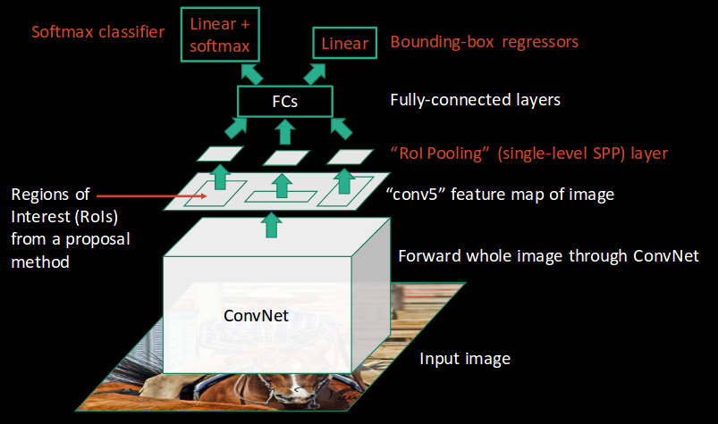
Fast R-CNN
Fast R-CNN, on the other hand, passes the entire image to ConvNet which generates regions of interest (instead of passing the extracted regions from the image). Also, instead of using three different models (as we saw in R-CNN), it uses a single model which extracts features from the regions, classifies them into different classes, and returns the bounding boxes.
All these steps are done simultaneously, thus making it execute faster as compared to R-CNN. Fast R-CNN is, however, not fast enough when applied on a large dataset as it also uses selective search for extracting the regions.

Slide 9
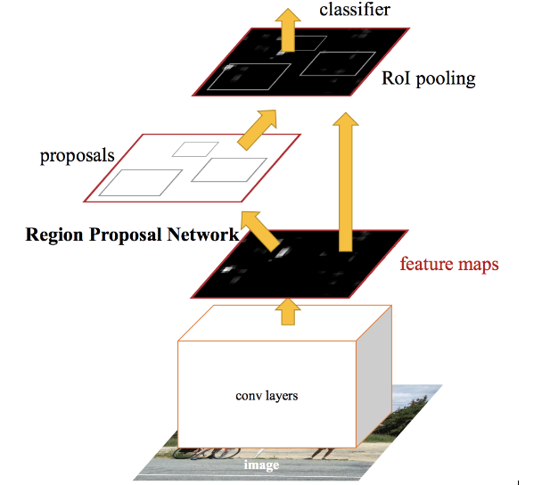
Faster R-CNN
Faster R-CNN fixes the problem of selective search by replacing it with Region Proposal Network (RPN). We first extract feature maps from the input image using ConvNet and then pass those maps through a RPN which returns object proposals. Finally, these maps are classified and the bounding boxes are predicted.
Faster R-CNN has two networks: region proposal network (RPN) for generating region proposals and a network using these proposals to detect objects
The time cost of generating region proposals is much smaller in RPN than selective search, when RPN shares the most computation with the object detection network.

Slide 10
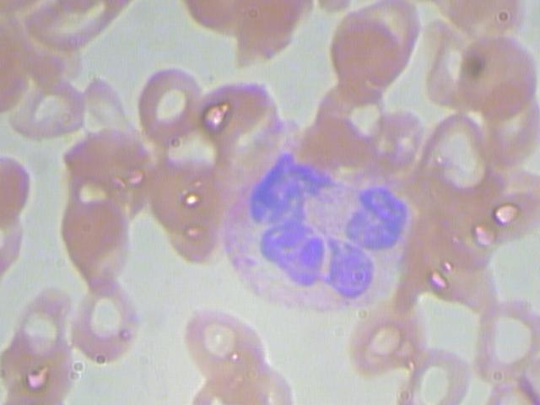
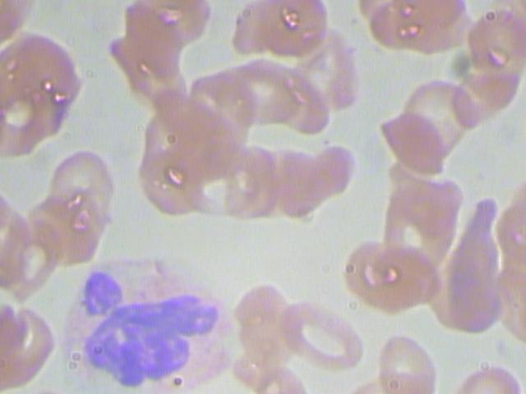
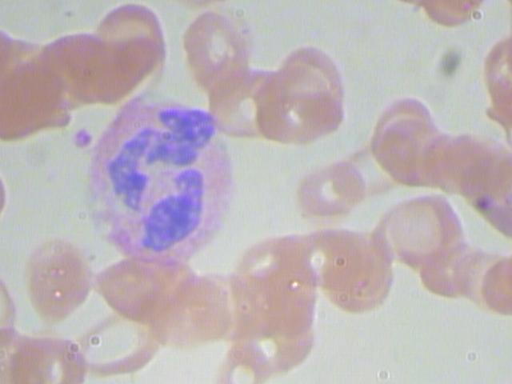
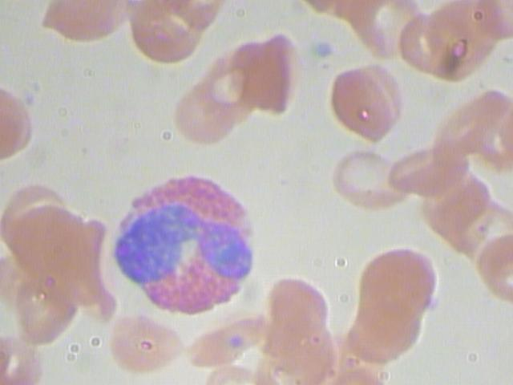
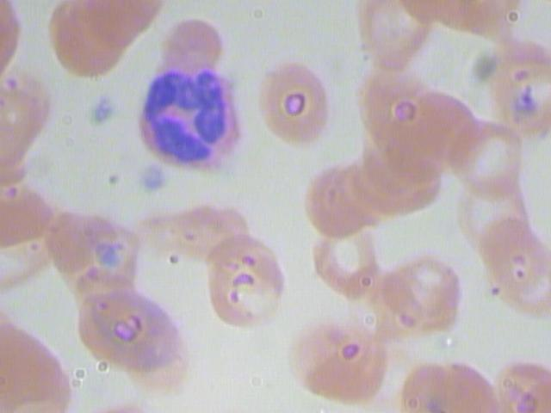
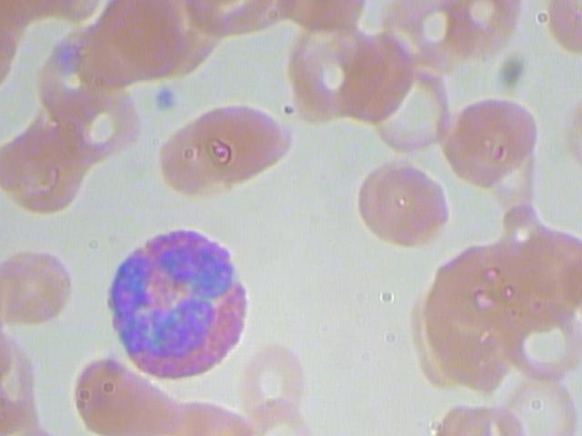
METHODOLOGY
We have divided the implementation of our project into the following steps:
a. Data Collection
consists of 1300 annotated microscopic blood sample images consisting of RBC
US National Library for Medicine

Slide 11
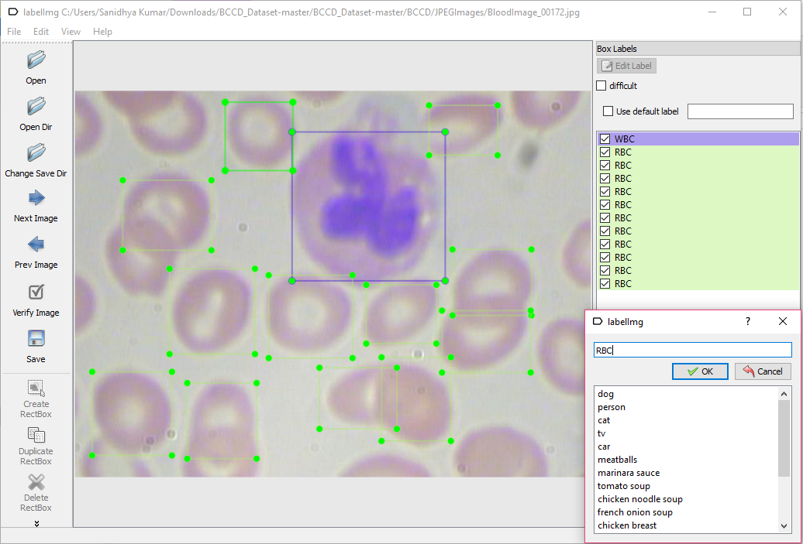
b. Label Pictures
We used LabelImg software for labeling the images(drawing bounding box) around them.
LabelImg->saves a .xml file (label data)
python xml_to_csv.py(to concert xml
-> csv file)
.xml files-> generate TFRecords ->inputs ->TensorFlow trainer. (generate_tfrecord.py scripts )

Slide 12
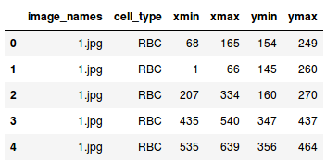
b. Data Exploration
# importing required libraries
import pandas as pd
import matplotlib.pyplot as plt
%matplotlib inline from matplotlib import patches
# read the csv file using read_csv function of pandas
train = pd.read_csv(‘train.csv’)
train.head()
The three files I have created out of the entire dataset are:
train_images: Images that we will be using to train the model. We have the classes and the actual bounding boxes for each class in this folder.
test_images: Images in this folder will be used to make predictions using the trained model. This set is missing the classes and the bounding boxes for these classes.
train.csv: Contains the name, class and bounding box coordinates for each image. There can be multiple rows for one image as a single image can have more than one object.

Slide 13
c. Run the Training
Each step of training reports the loss. It will start high and get lower and lower as training progresses. For my training on the Faster-RCNN-Inception-V2 model, it started at about 3.0 and quickly dropped below 0.8.
Loss used for training is a sum of Classification and Localization losses with the latter calculated only for boxes with the same class label as the ground truth.
Code:
python train.py --logtostderr --train_dir=training/ --pipeline_config_path=training/faster_rcnn_inception_v2_pets.config

Slide 14
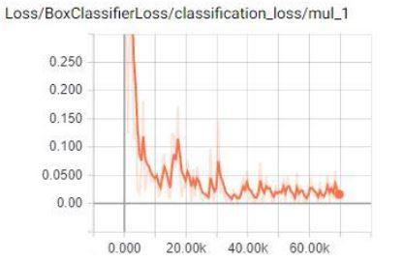
d. Export Inference Graph
The TensorBoard page provides information and graphs that show how the training is progressing. One important graph is the Loss graph, which shows the overall loss of the classifier over time.
The training routine periodically saves checkpoints about every five minutes. Now that training is complete, the last step is to generate the frozen inference graph (.pb file).

Slide 15
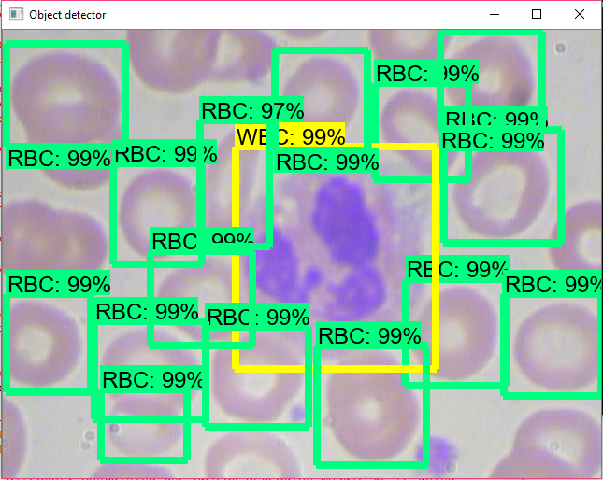

f. Object Detection Classifier Trained
We input any image of our choice (test img folder) or just plug in a USB webcam and point it at the objects (using Object_detection_webcam.py). and test our trained Object Detection Classifier. Success!
Code to Count Blood Cells:
# train[‘cell_type’].value_counts()
train[‘RBC’].value_counts()
train[‘WBC’].value_counts()
train[‘Platelets’].value_counts()

Slide 16
Tools Used:
a. Python 3.6
b. Anaconda distribution
c. Tensorflow
d. Faster-RCNN-Inception-V2-COCO model
e. LabelImg Software
f. OpenCV
g. pandas
h. matplotlib
i. keras — 2.0.3
j. numpy
k. sklearn
l. h5py

Slide 17
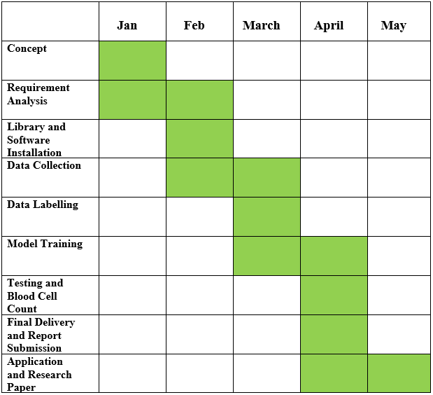
Time Line Distribution

Slide 18
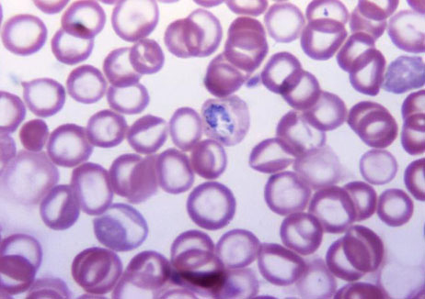
FUTURE IMPLEMENTATION
We are currently working on a research paper on Malaria Parasite Detection on Blood Cells using Convolutional Neural Networks under the guidance of our mentor Dr. Mahesh Jangid.
We have implemented Model Resnet 101 and Resnet 34 and further working on Alexnet, VGG-16, Xception, DenseNet-121 to further on the accuracy to detect Malaria Parasite.
We will measure our train_loss, valid loss and accuracy against the number of epochs to determine which model is better.
Malaria parasites can be identified by examining under the microscope a drop of the patient’s blood, spread out as a “blood smear” on a microscope slide. Prior to examination, the specimen is stained to give the parasites a distinctive appearance. However, it depends on the quality of the reagents, of the microscope, and on the experience of the laboratorian.

Slide 19
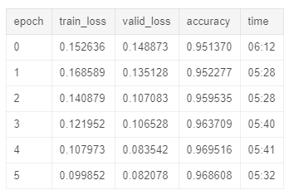
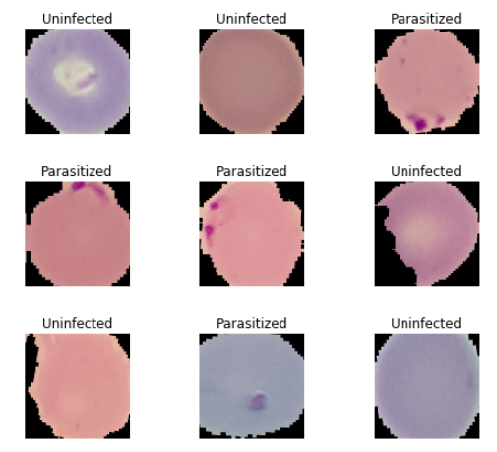
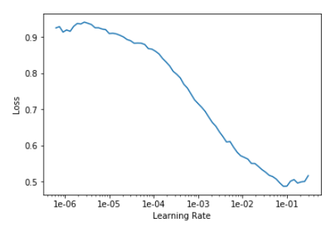
RESNET 101 Model Results

Slide 20
Individual Contribution
Member 1: Satabdi Nayak:
Collected Data of Blood Cell and Malaria affected blood cell images from US National Library for Medicine
Labeled data using LabelImg software
Seggregated dataset into 2 folders-infected and un infected
Defined requirement specification
Documentation-synopsis, presentation
Conversion of xml data to csv files of both training and testing folders
Project Report: Abtract, Introduction, future work and conclusion
Research Paper: introduction, abstract,previous work, pre requisite Methodology, accuracy table,
Ran Malaria Dataset on Model Resnet 101, noted accuracy, train_loss,valid_loss

Slide 21
Individual Contribution
Member 2: Sanidhya Kumar
Environmental Variables and library installation like Python, Matplotlib, jupyter.etc
Installation and set up of required softwares and APIs
Selection of Deeplearning Model (Faster RCNN)
Coding using Anaconda Prompt, Jupyter and Google Colab
Training of Object Detection Classifier
Tested our Object Classifier on Blood Sample Test images.
Implemented code for counting blood cells.
Trained and tested Malaria Dataset on Model Resnet 34, tabulated accuracy, train_loss,valid_loss
Project Report:Methodology, Implementation and results, Previous work,list of tables, Background overview.

Slide 22
References: a. Relevant Research Papers
Ross Girshick, Jeff Donahue, Trevor Darrell, and Jitendra Malik. Rich feature hierarchies for accurate object detection and semantic segmentation. In The IEEE Conference on Computer Vision and Pattern Recognition (CVPR), 2014.
Ross Girshick. Fast R-CNN. In International Conference on Computer Vision (ICCV), 2015.
Shaoqing Ren, Kaiming He, Ross Girshick, and Jian Sun. Faster R-CNN: Towards realtime object detection with region proposal networks. In Advances in Neural Information Processing Systems (NIPS), 2015.

Slide 23
b. Web
This is the Tensoflow Github Repository which lists its installation, implementation, usage, ML Training models and Guidelines. https://github.com/tensorflow/tensorflow.
Github Repository for LabelImg. LabelImg is a graphical image annotation tool. It is written in Python and uses Qt for its graphical interface. https://github.com/tzutalin/labelImg

